Slide 1
Project 1: Controlled Evalbot Movement Design Review
EECS 690: Advanced Embedded Systems
Nilisha Mane, Cassandra Post, Monica Shafii

Slide 2
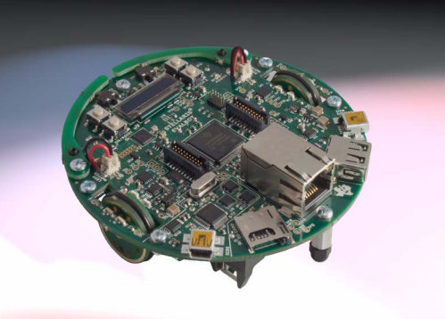
Stellaris® LM3S9B92 EVALBOT Robotic Evaluation Board (EVALBOT)
Source for image: http://www.ittc.ku.edu/~gminden/Embedded_Systems/PDFs/TI_Stellaris_LM3S9B92_EVALBOT_UM.pdf

Slide 3
Project 1 Goals
(Wired) EVALBOT will move across the desk in the Eaton Lab in a controlled fashion.
EVALBOT will calculate and show distance travelled in feet on OLED display.

Slide 4
Testing the Results
Place straight-edge alongside EVALBOT’s path to ensure it is travelling in a fairly straight line (this is good enough for our intents and purposes).
Set starting and finishing “walls” up on path at a fixed distance, perform 25 test runs and compute average distance recorded, compare against actual, ensure percentage of error is adequate to pass testing phase

Slide 5
Design
Created flowcharts to show structure of desired project and the order of tasks.
Project 1: Task_EvalDrive

Slide 6
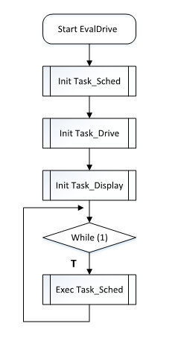
Task_EvalDrive

Slide 7
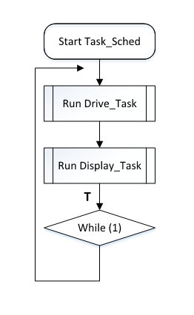
Task_Sched

Slide 8
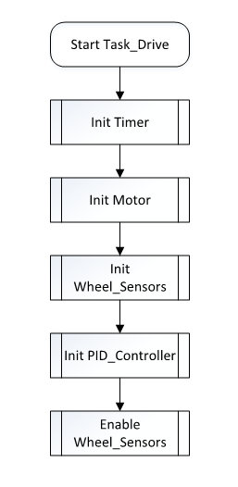
Task_Drive

Slide 9
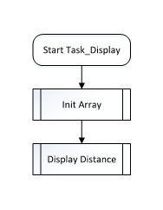
Task_Display

Slide 10
Questions/Suggestions?

